Slide 1
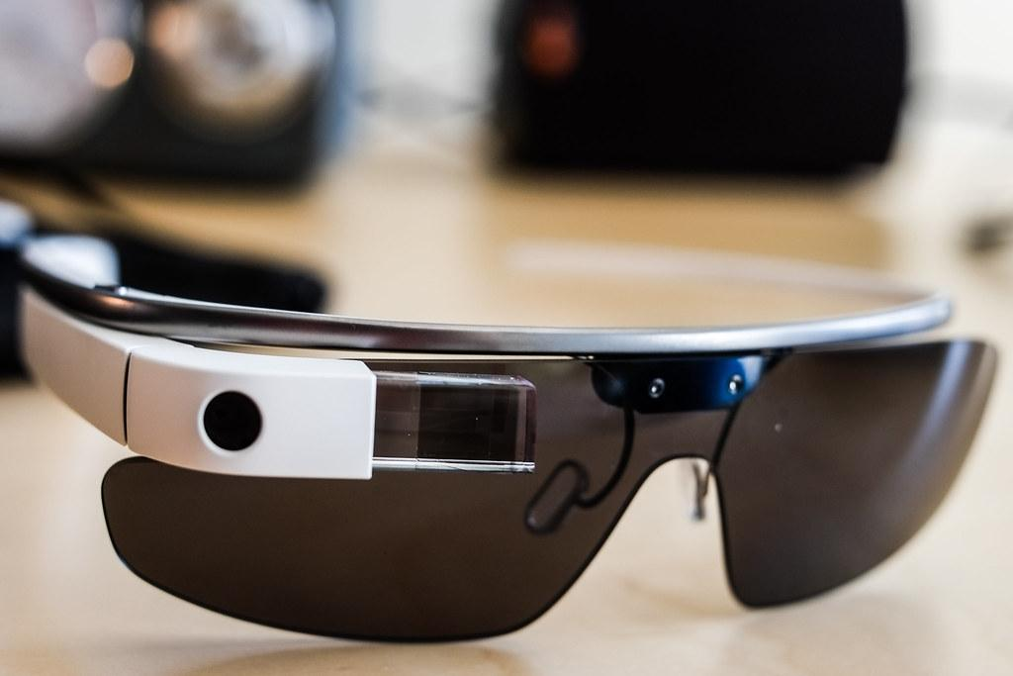
Project IRAS
Group 4
(Intricate Real-time Assistance Spectacles)
Group Members
Carlos Acosta, PSE, Project Lead
Darlandie Moise, PSE
Kim Le, CS
Brian Umbretcht, CS

Slide 2
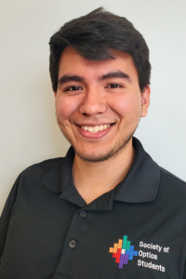
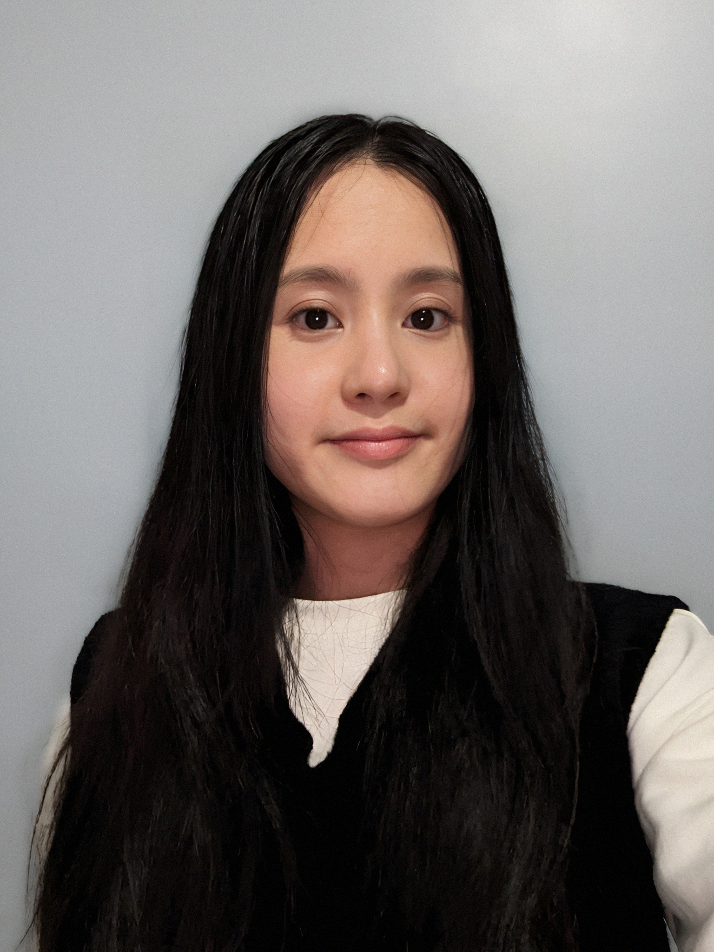
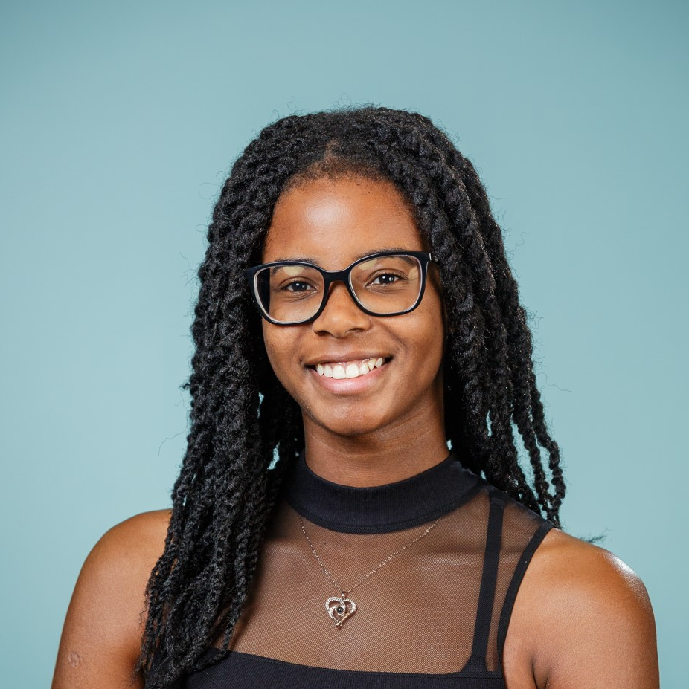
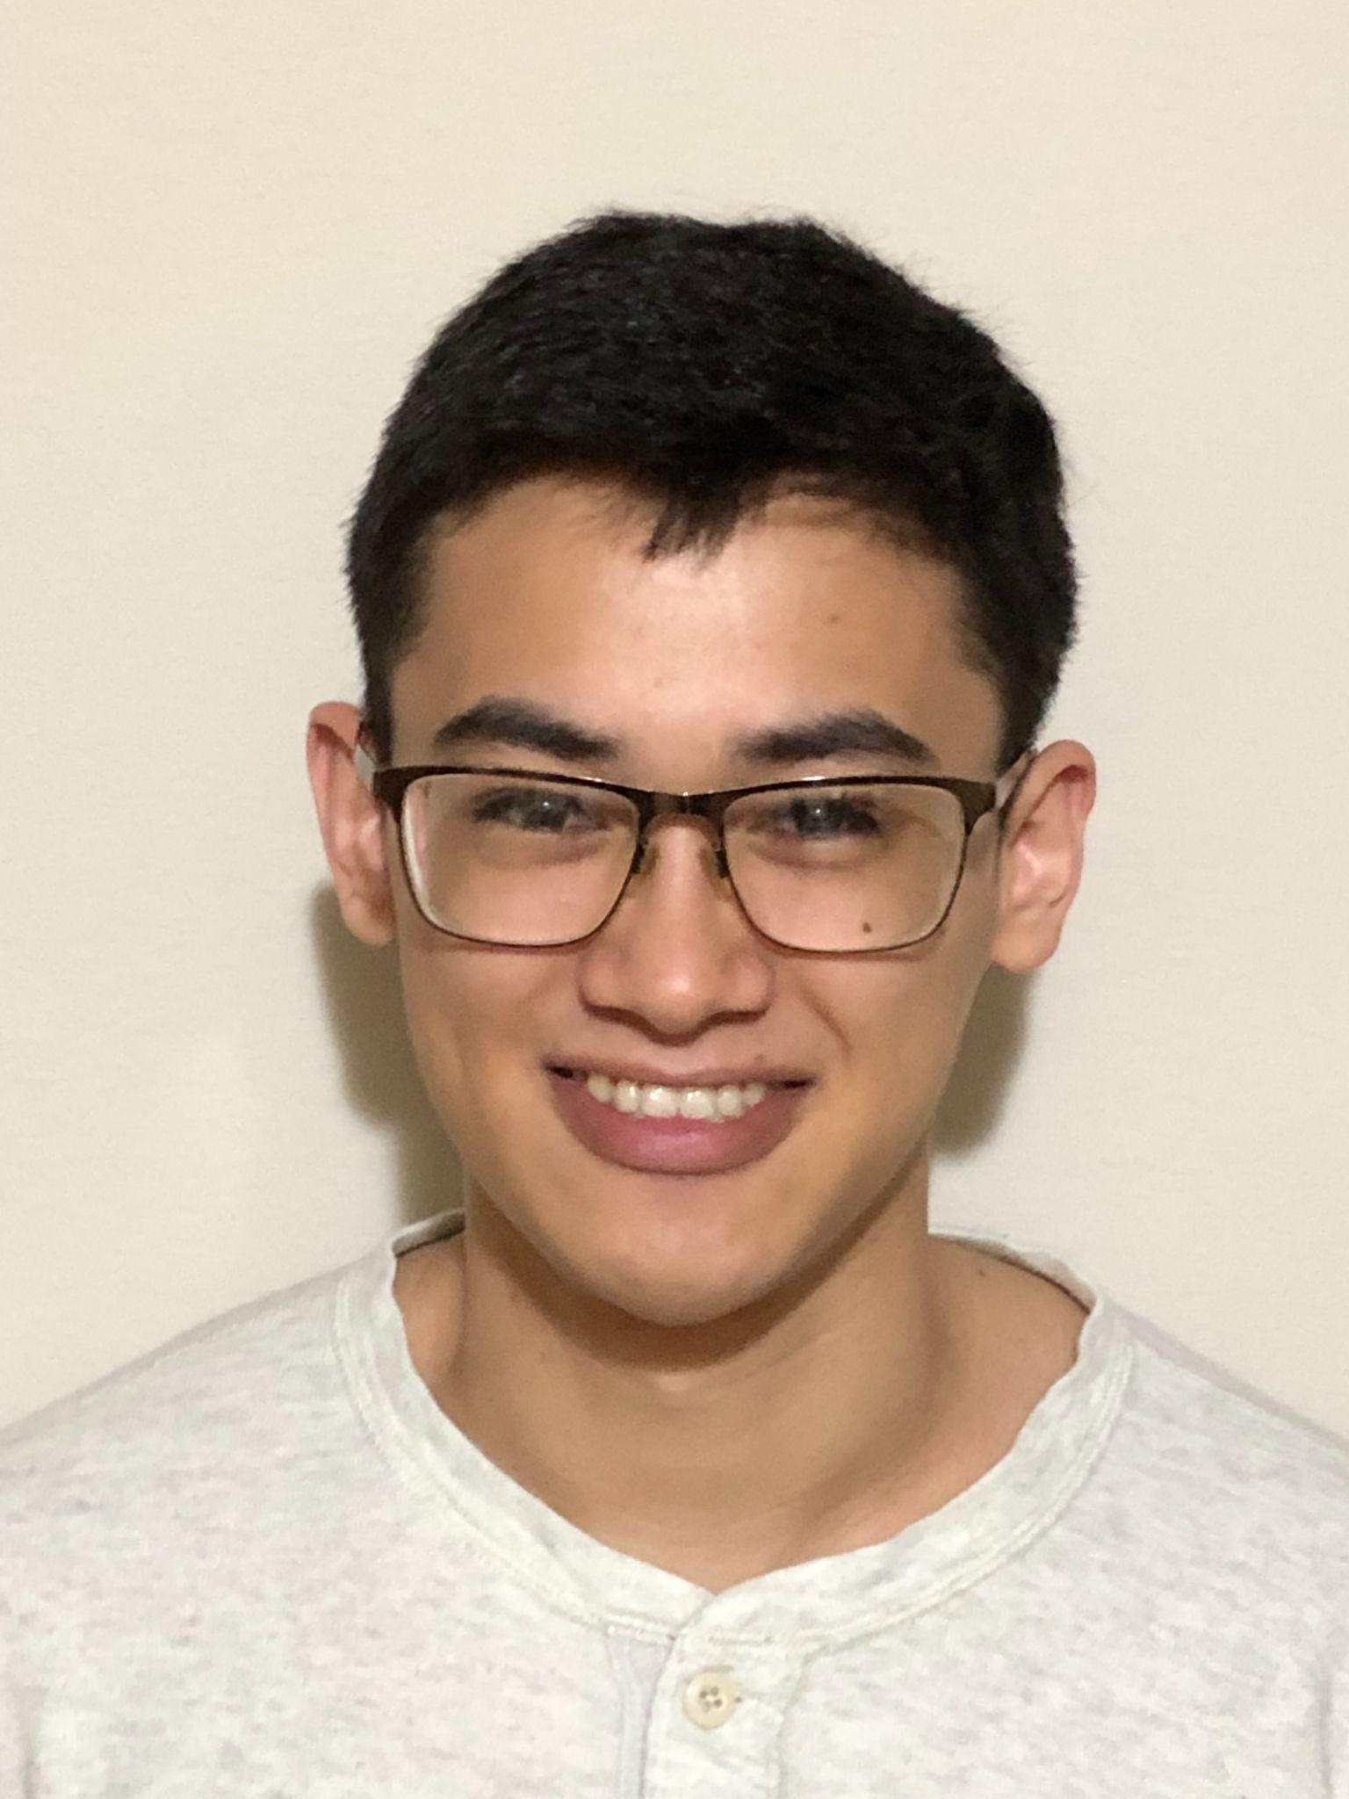
Introduction: Who is IRAS?
Carlos Acosta, PSE, Project Lead
Kim Le,
CS
Darlandie Moise, PSE
Brian U,
CS

Slide 3
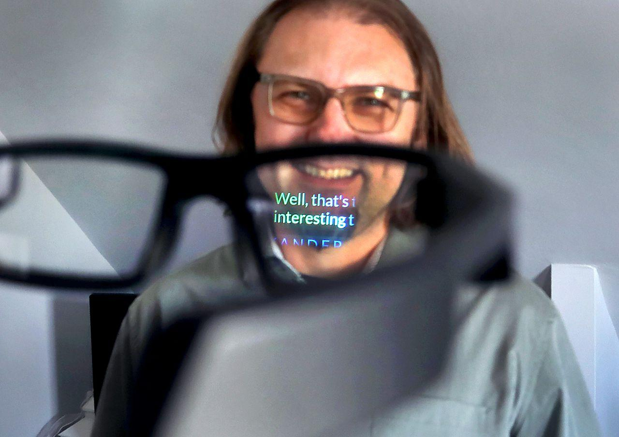
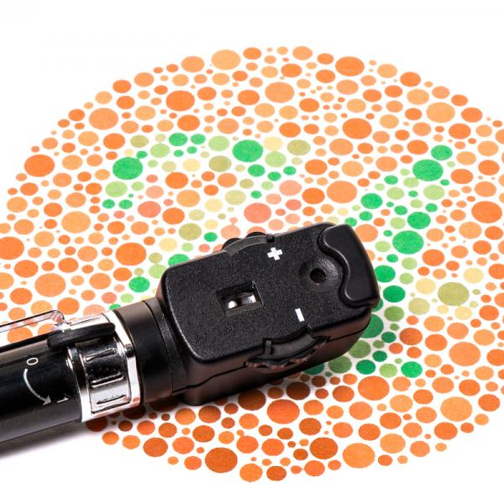
Introduction: What is IRAS?
Intricate Real-Time Assisted Spectacles (Speech-to-Text and Color Detection Glasses)
C

Slide 4
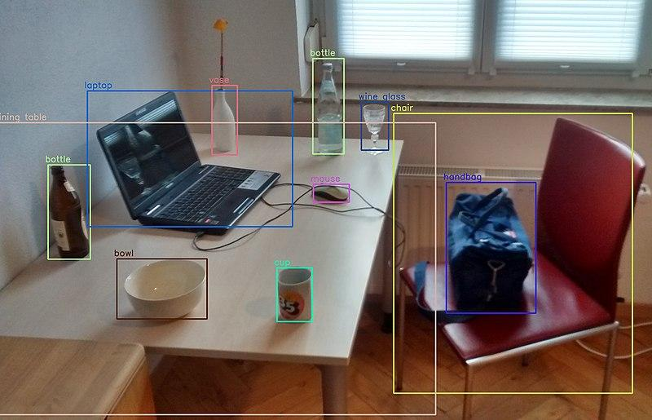

Motivations and Goals
Millions of people are affected by deafness and color blindness
We want to create a functional and wearable device that will display live captions and highlight areas that have certain colors.
This will help the deaf/hard of hearing, elderly, color blind people, and help people who want to improve their comprehension of other languages.

Slide 5
Objectives
The Parts, The Systems, and The Photonics
Gather parts provided
Design multiple optical systems
AR projection
Wide Angle Camera
Perfect each optical design with trial and errors
Ta Da! We made the photonics needed for our glasses.
Implement real-time subtitles, and translation for face-to-face conversations.
Setup a speech to text service, display transcriptions.
Develop a color detection system to aid color-blind users.
Utilize OpenCV to detect colors, display a bounding box around those colors
Develop a mobile app for remote control of the glasses.
Optimally we’ll use existing options such as Blynk.
We want to control which mode is active, and configure the settings for both modes.
Notes:
FIX

Slide 6
The Engineering Specifications
Components | Parameters | Specifications
MCU: ESP32 | Processing Power, RAM, Memory Capacity | GHz, 8MB, up to 32 GBs of external storage
Antenna | Transmission Range | 50m-100m
Camera: OV5640 | Resolution and FOV | Between 2-5 MP. FOV; ~60 - 80 Degrees
Micro-OLED | Text and Color Accuracy | >80%
Frame of Lense Designs | Weight | ~500 grams
Battery* | Longevity | ~1 hour
M12 Lenses | Distortion | ~1% error
Near Eye Display | Size and Transparency | 1.5 Inches diagonal, 90% transparent
D
Notes:
FIX

Slide 7

Hardware Design
Bluetooth
Camera
Primary MCU
Secondary MCU
Display
Microphone
Reflector
C

Slide 8
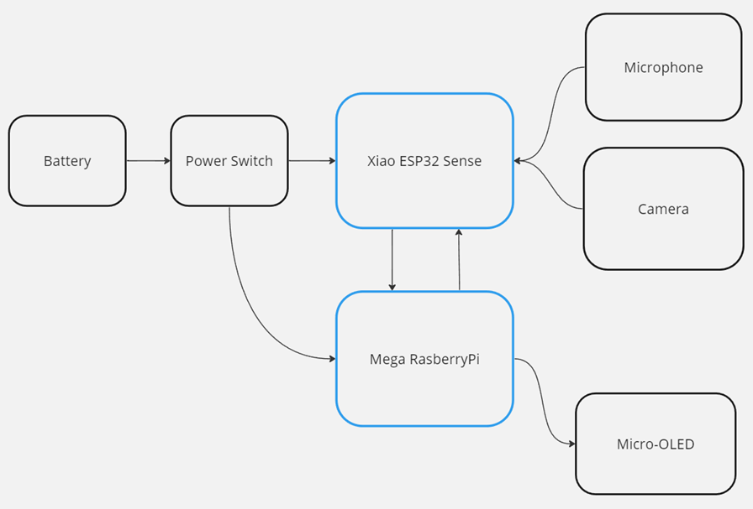
Hardware Schematic
C

Slide 9
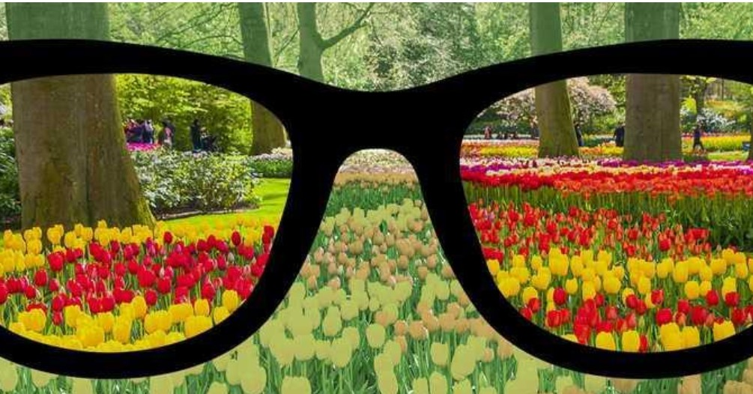
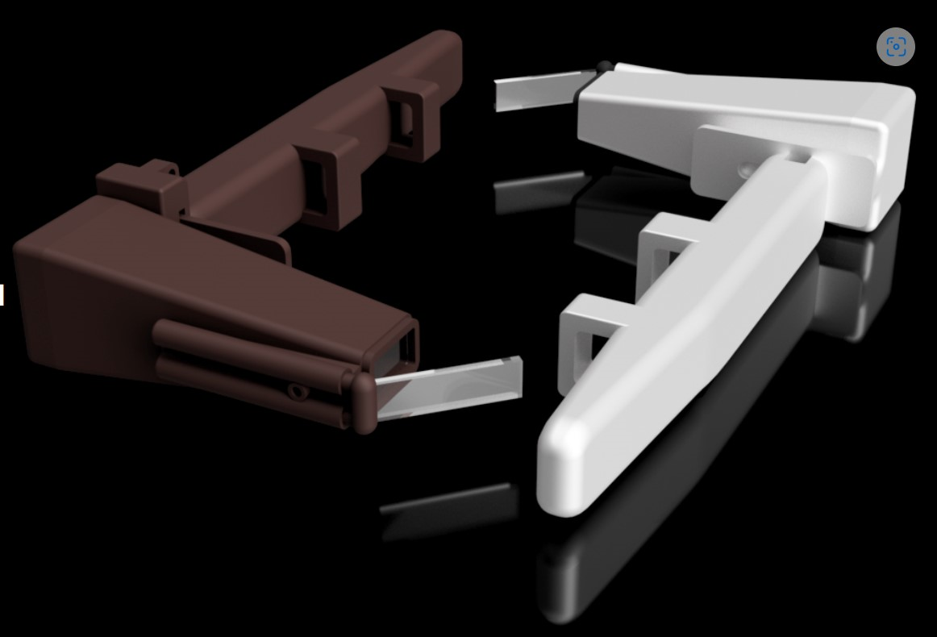
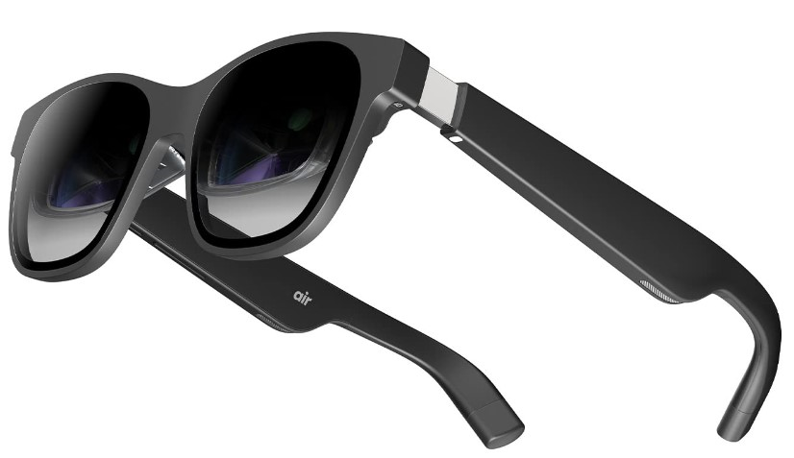
Current Technological Comparison
 | Colorblind Glasses | Transcribe Glass | XRAI Glasses
Details | Effective for those with certain color blindness. Lacks customization and environmental factors. | Easy to use. Has closed captions. MUST have frame. Low quality. | AI Assistance. Customizable on smartphone. Lack of other accessibility accommodations.
Tweaks | Expand customizability for color blindness. | Enhance flexibility for non glasses users. | Make sure both hearing impaired and color blind users are accommodate.
Imagery
D

Slide 10
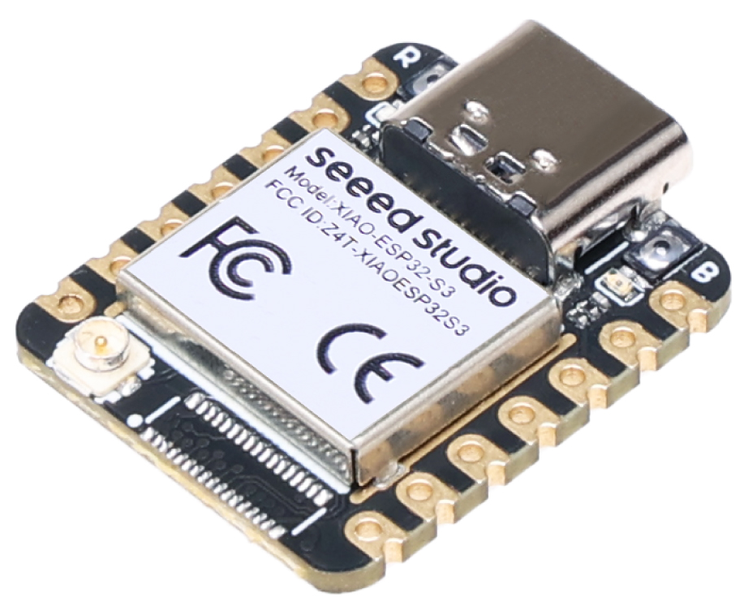
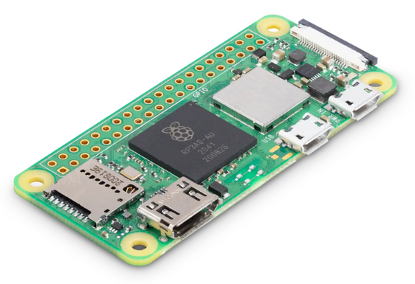
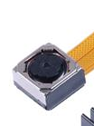
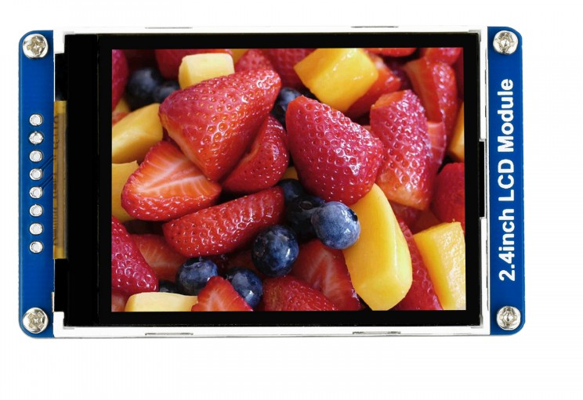
C
Hardware Components
Xiao ESP32S3
Small, but packs a punch
Microphone
Ov5640 5MP Camera
Compatible with ESP32
Extra features
60° FOV
Auto-Focus
Raspberry Pi Zero W2
Python Library
1.5” LCD TFT Display
Compatible with ESP32 & Raspberry Pi
Bright (hopefully)
1
2
4
3

Slide 11
Parts/Technical Reasons
Commercially available
These components are what’s available on the market.
Lenses are NOT cheap
The boards, display, and camera can easily be switched out.
Compatibility
Flexibility
Allow any user to wear these glasses.
Everyday use.
Simplicity
Capitalize on using 2 models in social and environmental interactions.
Easy for anyone to start using and customizing these glasses.
Affordability
Less complexity = Cheaper usage.
Minimalistic
Keep the design small and simple, as long as it works!
D

Slide 12
Successes/Difficulties
Difficulties
Expensive
Durability/Processing Power
Compatibility/Connectivity
Finding the right display with the right MCU…
Size/Weight
Housing all the components to still be wearable
Form Factor
WiFi Connection
Can’t connect to UCF WiFi
Successes
Camera
Livestream with wide FOV
Micro-OLED
Power it on and see texts and images
Display text on a reflector
MCU
Both the camera and micro-OLED will be connected to one board
Speech to text set up, text displaying
D

Slide 13
Impact of Design Constraints
Manufacturability
Material Selection
Integration of Components
Difficulty find compatible parts and small in size
Economic
Parts can be very expensive to purchase
Health & Safety
Safety concerns with wearing electronic components
Safe operations to avoid visible flickers that may cause issues to the user
D

Slide 14
Work Distribution
Camera Lens Design
Carlos Acosta
Near Eye Projection Design
Darlandie Moise
Framework
Carlos Acosta, Darlandie Moise
Live Transcription and Translation
Brian Umbrecht
Live Color Detection
Kim Le
Mobile app
Brian Umbrecht, Kim Le
D

Slide 15
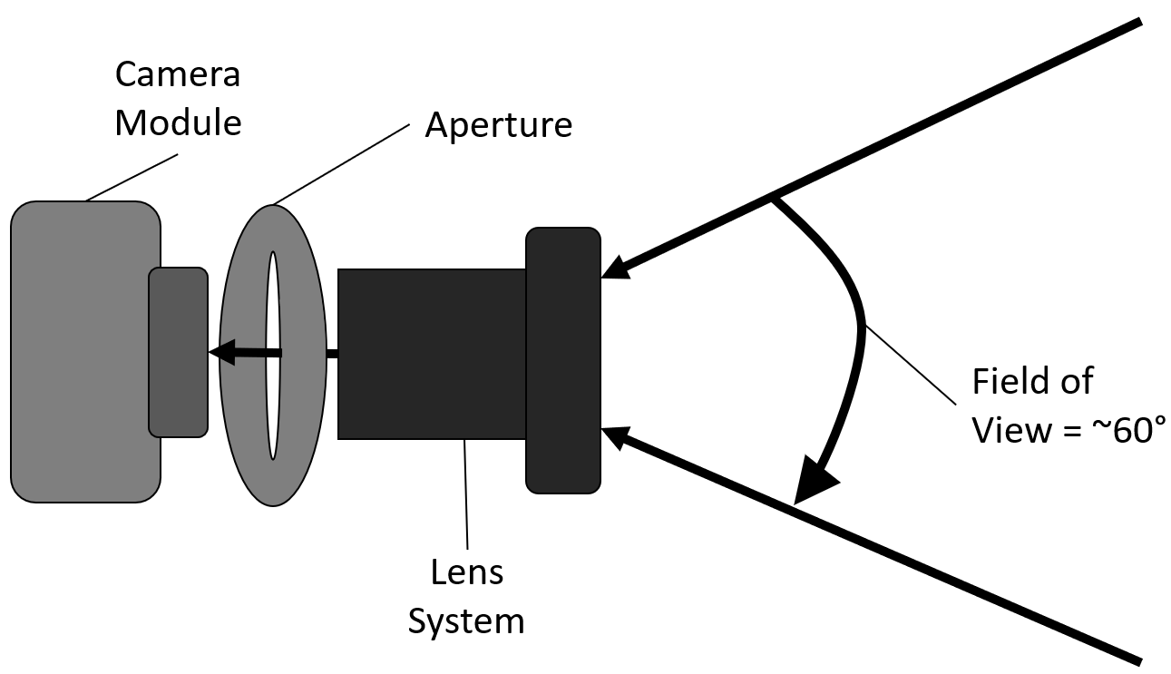
Schematic of Optical Design
C

Slide 16
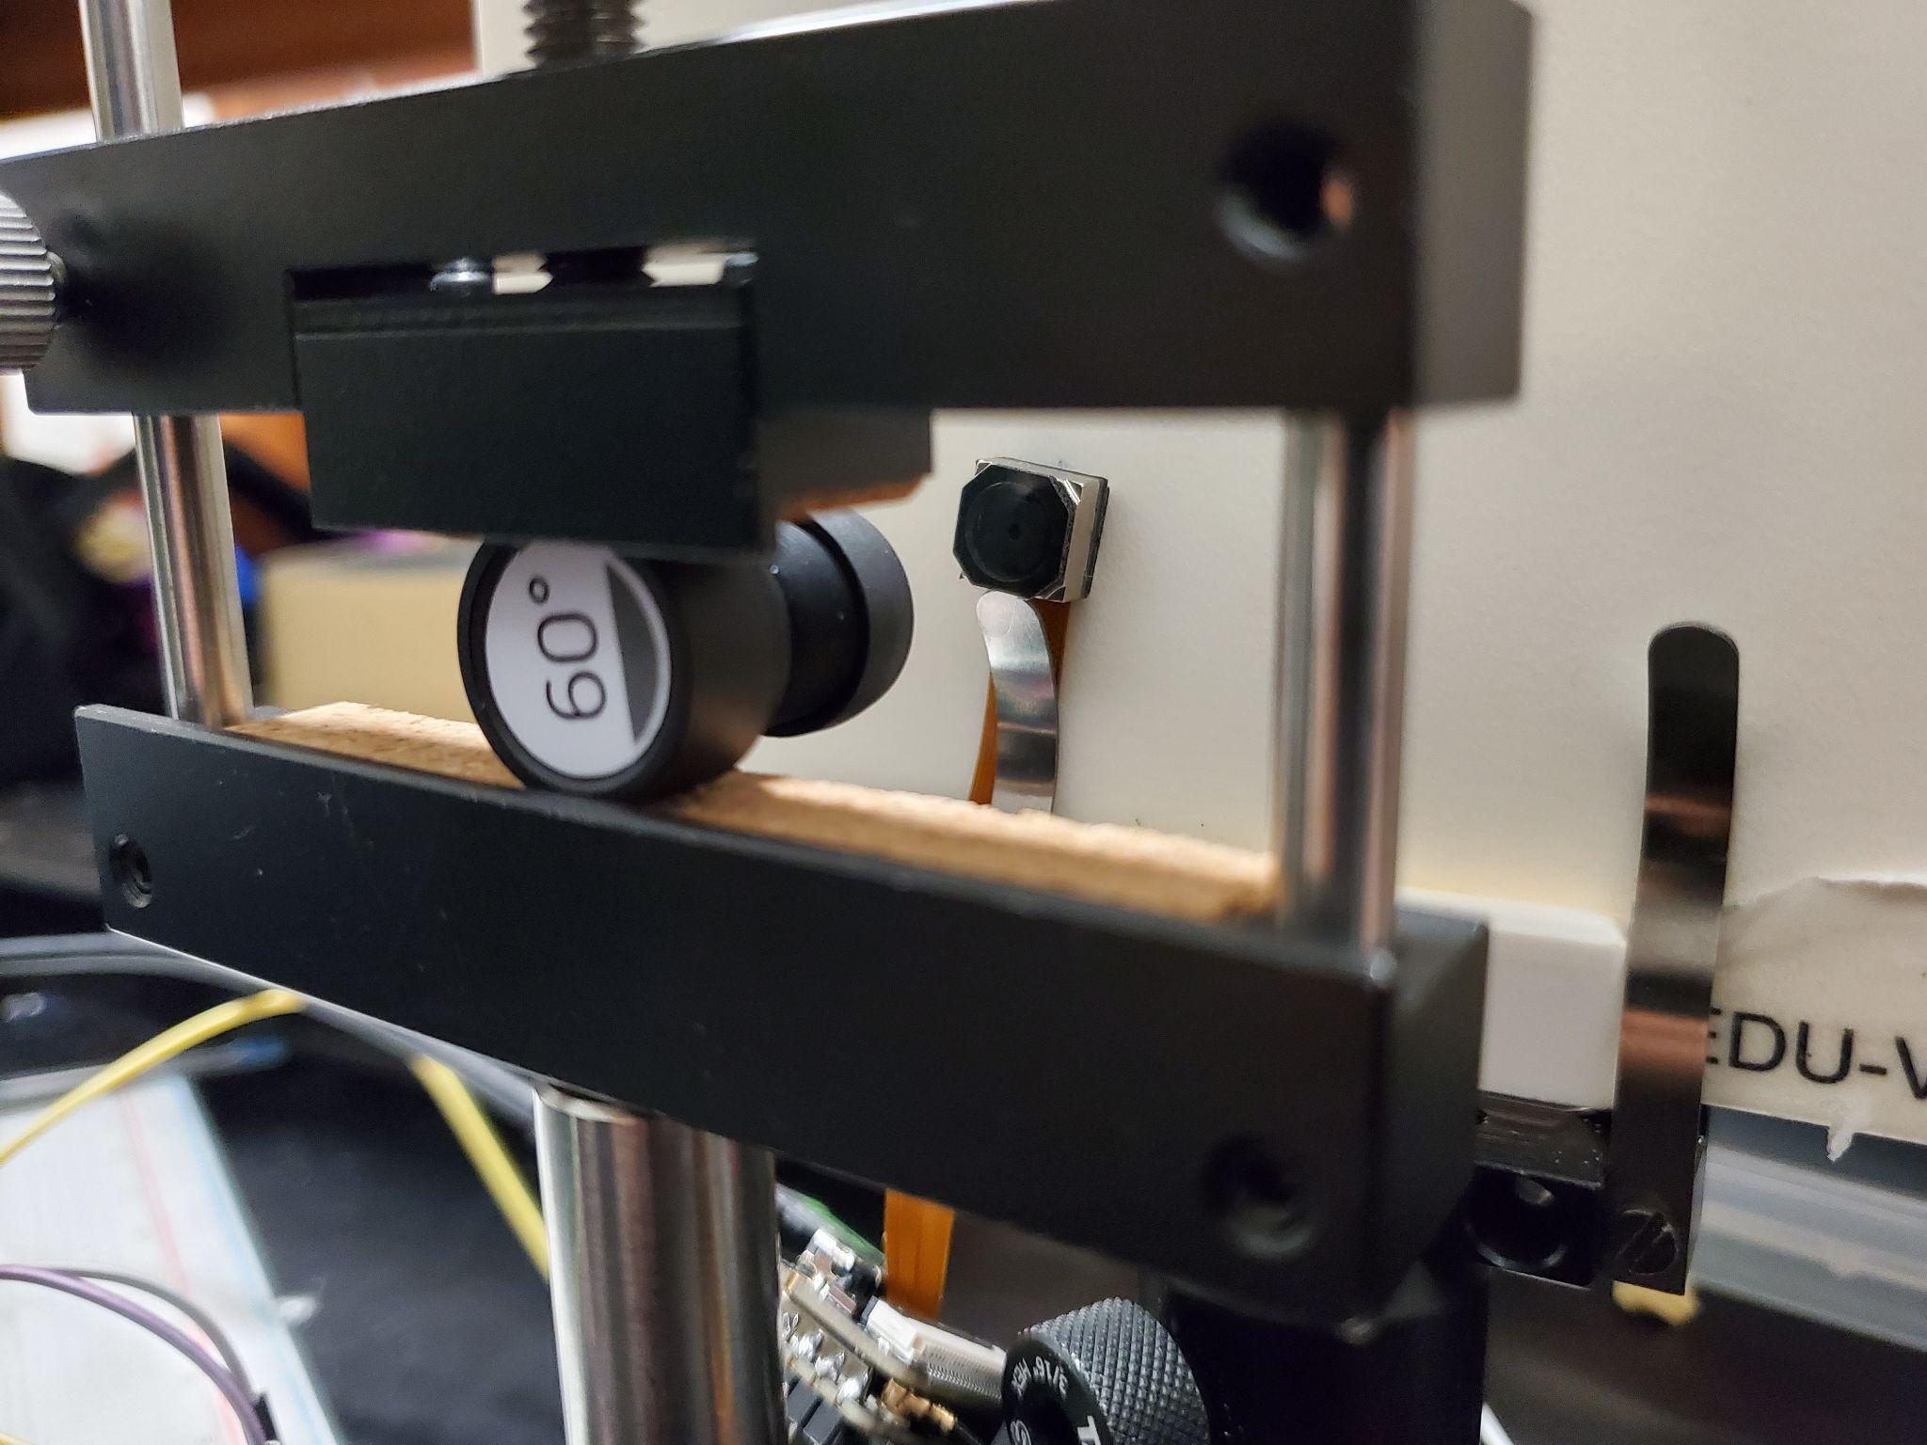
Camera Lens Setup
Camera
Lens System
C

Slide 17
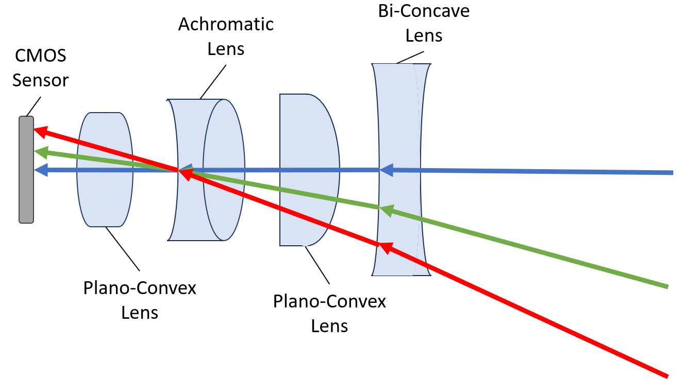
Schematic of 60° Lens System
C

Slide 18
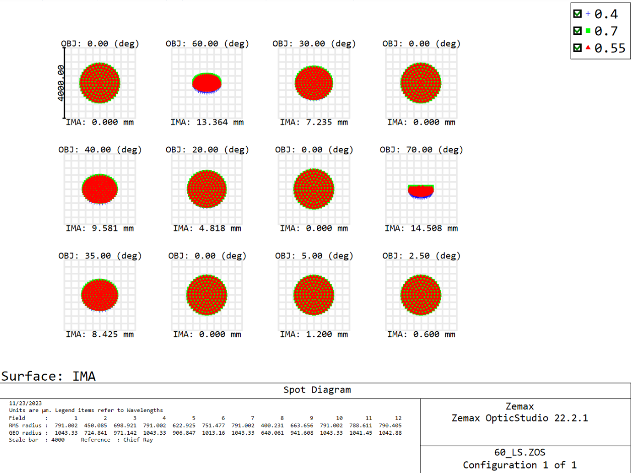
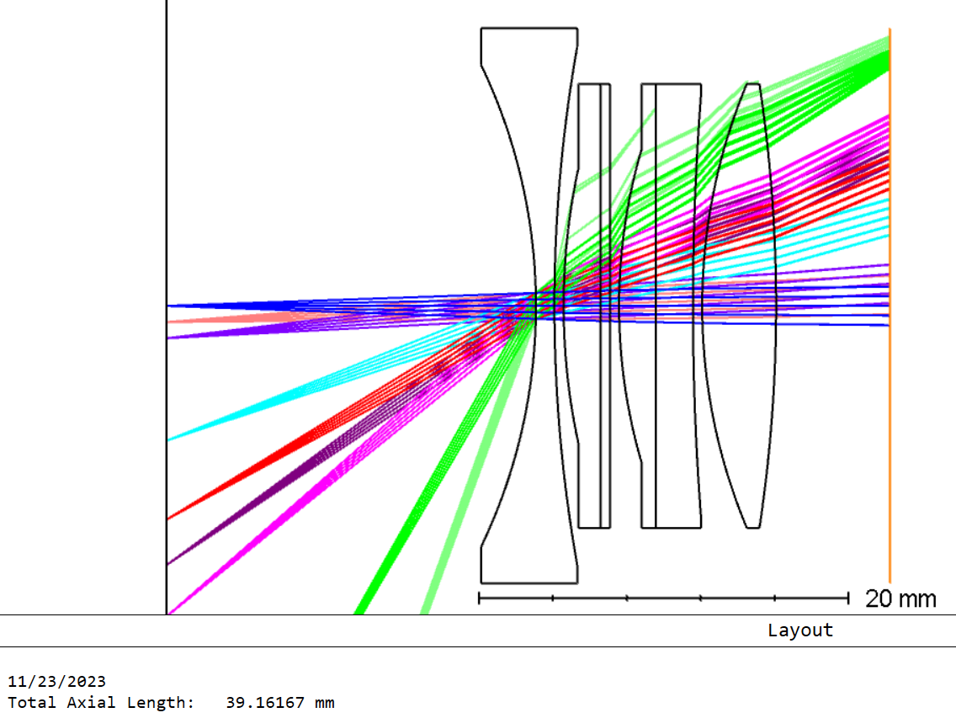
Zemax
C

Slide 19
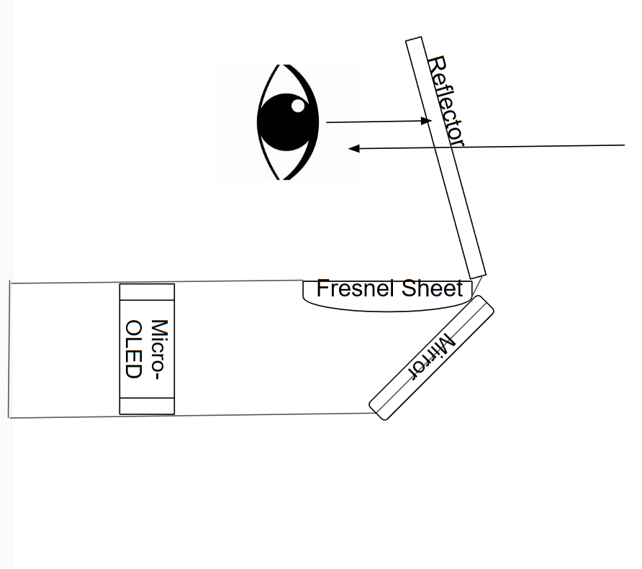
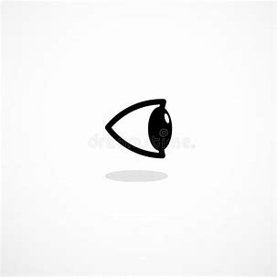
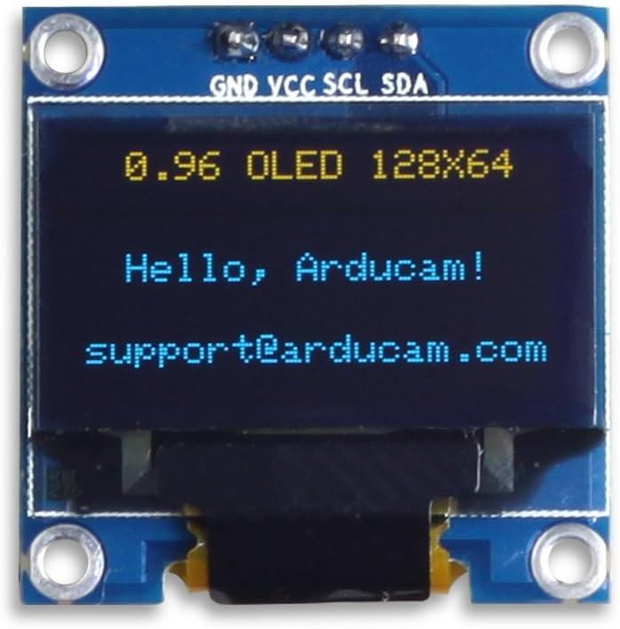
Near Eye Projection Setup
Reflector
Micro Display
Mirror
Collimating Lenses
D

Slide 20
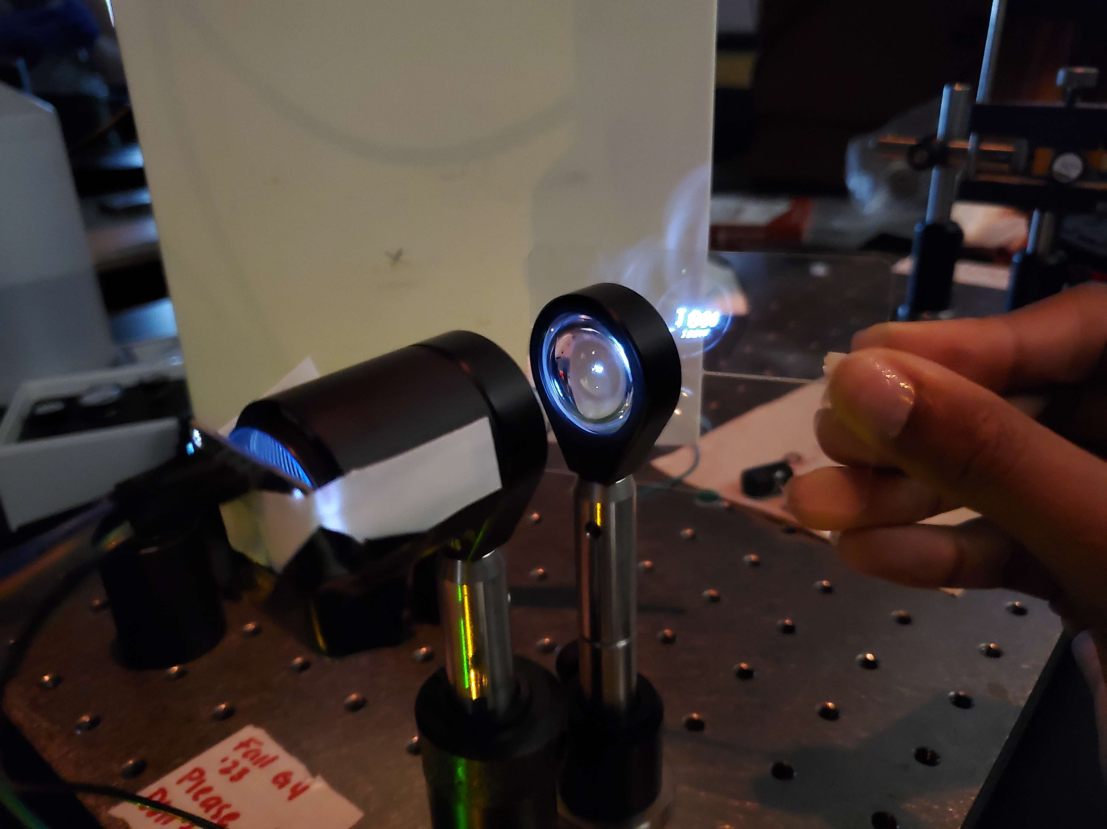
Near Eye Projection Setup
Reflector
Micro-OLED
D

Slide 21
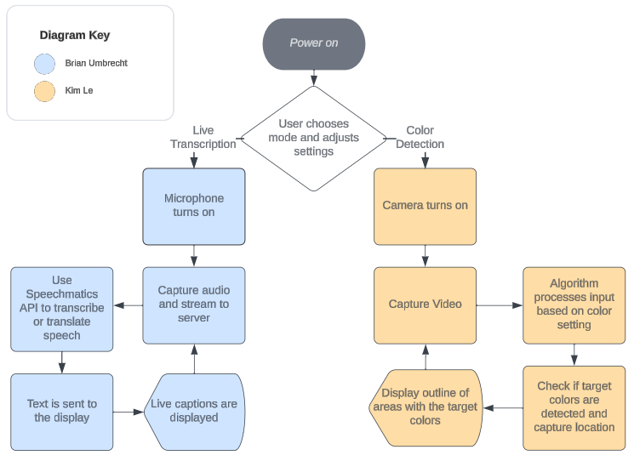
Software Flowchart
B

Slide 22
No ECE? No Problem!
No PCB Requirement
Simple Connections
Wireless communication with MCUs
Direct connections from built-in mic and replaceable camera/display.
Simple framework for device
Optics housing
Challenge: Power Supply…
⚡
ESP32S3
Raspberry Pi Zero W2
LCD TFT Display
Power Source
C

Slide 23

Live transcription
We’re using Speechmatics for transcribing speech.
Speechmatics offers accurate transcriptions, multiple languages, translation, and a free trial.
Different types of transcription; batch and real-time.
We’ll use real-time to allow transcribing speech as it comes in.
Uses WebSocket API.
Documentation doesn’t indicate how to implement in C++.
Difficult to implement just in Arduino IDE, so use a server.
B

Slide 24

Server
We’ll use a server to interact with Speechmatics and our ESP32S3.
Node.js is a popular and easy to use tool.
WebSocket used to stream audio from the ESP32S3 to the server.
WebSocket used again to stream audio from server to Speechmatics.
Server will send transcription back where text can be displayed.
We’ll host the server online using AWS; free
Allows for a consistent WebSocket connection point, as opposed to hosting the server locally.
Testing has shown this system works. Some inconsistencies in connecting and transcribing, possibly due to the wire powering the ESP32S3.
B

Slide 25

Server
Example of live transcription working
Translation can be added with additional setup.
Latency can be reduced by adjusting the config in the server.
B

Slide 26
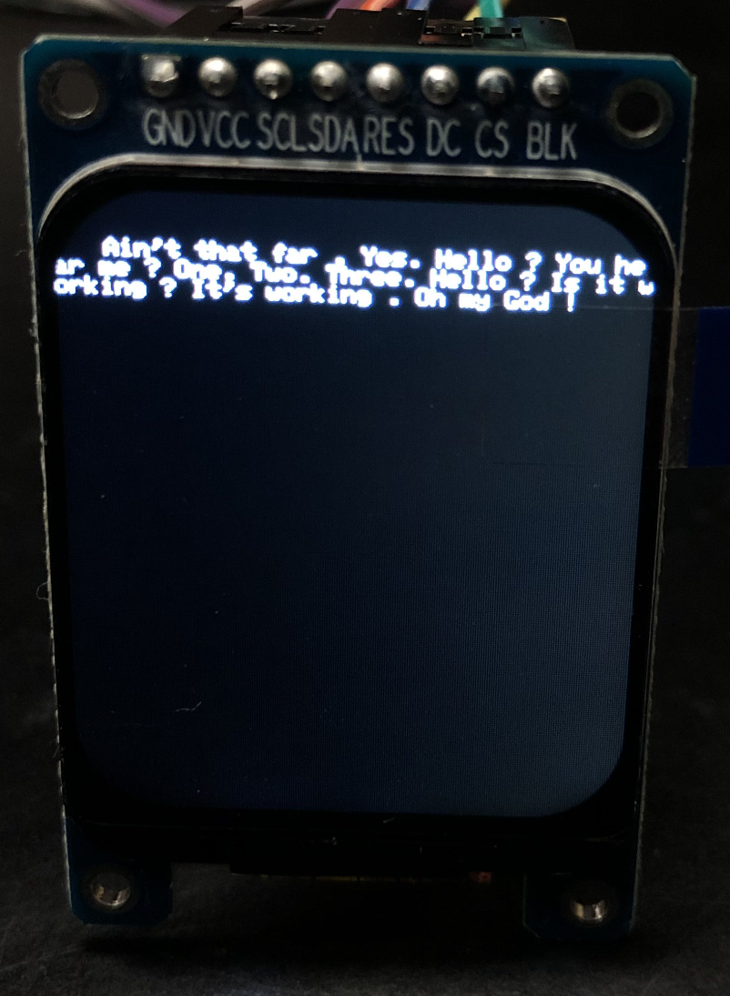
Text Display
Speech to text functioning on display
Text can be adjusted to change size, color, position, etc.
Testing showed that a strong WiFi connection is optimal.
Significant lag, and some speech wasn’t transcribed.
B

Slide 27


Transcribing other languages
Example of Spanish transcribed into Spanish
Example of English speech translated into Spanish
Many other languages supported but only from Other languages into English and vice versa.
B

Slide 28
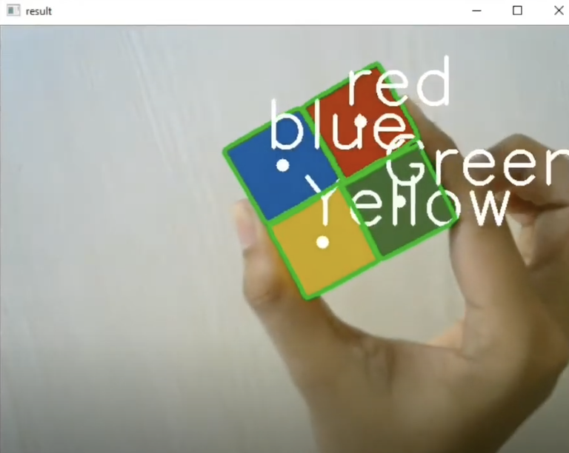
Live Color Detection
OpenCV is a versatile computer vision library for image and video analysis.
Provides a comprehensive set of functions that can be used for color space conversions, thresholding, and various other operations crucial for color detection.
Designed to handle real-time processing of video streams and frames.
Optimized for resource-constrained platforms like the ESP32S3.
Popular with a strong community and continuous support.
K

Slide 29
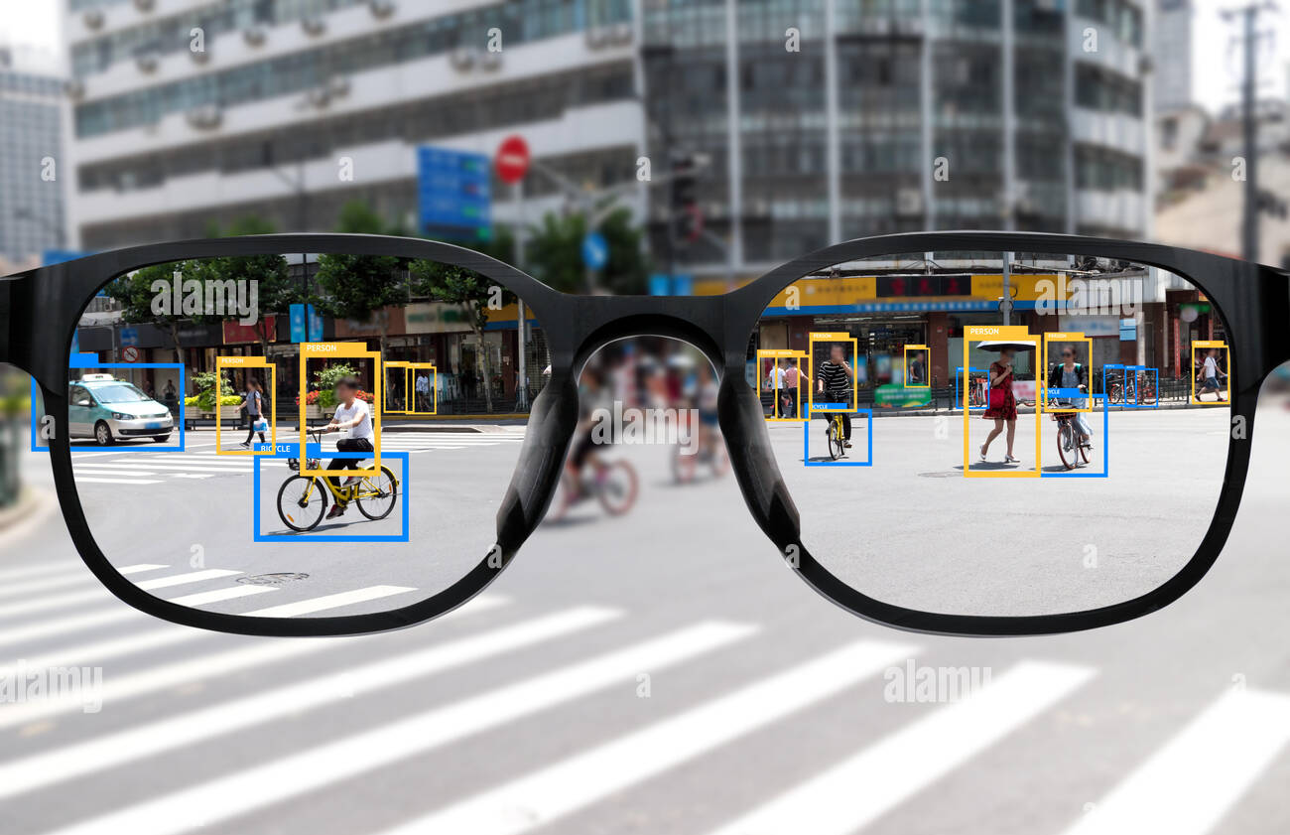
GUI Design
Minimalist Design: Focuses on essential information and functions to avoid overwhelming users.
Optimized Text Sizes: Carefully selected font sizes for easy readability.
High Contrast for Readability: Ensures clear visibility under different lighting conditions.
SquareLine is a cross-platform app that comes with a visual drag-and-drop interface that allows us to customize UI elements with real time preview features without the need for extensive coding.
K

Slide 30
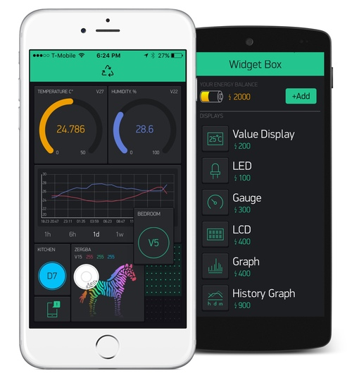
Mobile app
User-Friendly Interface: Eliminates the need for physical buttons or complex gestures, ensuring discretion.
Extended Functionality: Offering personalized settings and connectivity with other devices.
Over-the-Air (OTA) Updates: Serves as a platform for seamless firmware and software updates. Facilitates remote troubleshooting and maintenance.
Current Mobile App Options: Blynk, Ubidots, ThingSpeak, Cayenne, and MQTT Dash.
Considerations for Future Development: Custom Mobile App
K

Slide 31
Administrative Content
Budget
Battery Pack
$15
Raspberry Pi Zero 2 W
$15
Xiao ESP32S3 Sense
$25
OV5640 Camera
$25
Micro Display
$6
Frame
$10
Lenses
$90
Total: $186
Progress
Purchased and received all components
100% completed
Color Detection
20% completed
Live Transcription / Translation
80% completed
Mobile App
0% completed
Camera Lens Design
80% completed
Near Eye Projection Design
55% completed
Plans for Completion
Weekly meetings to track progress of each subsystem.
Test to ensure each part runs smoothly and electrical issues are resolved early on.
Use Jira to set weekly objectives.
D

Slide 32
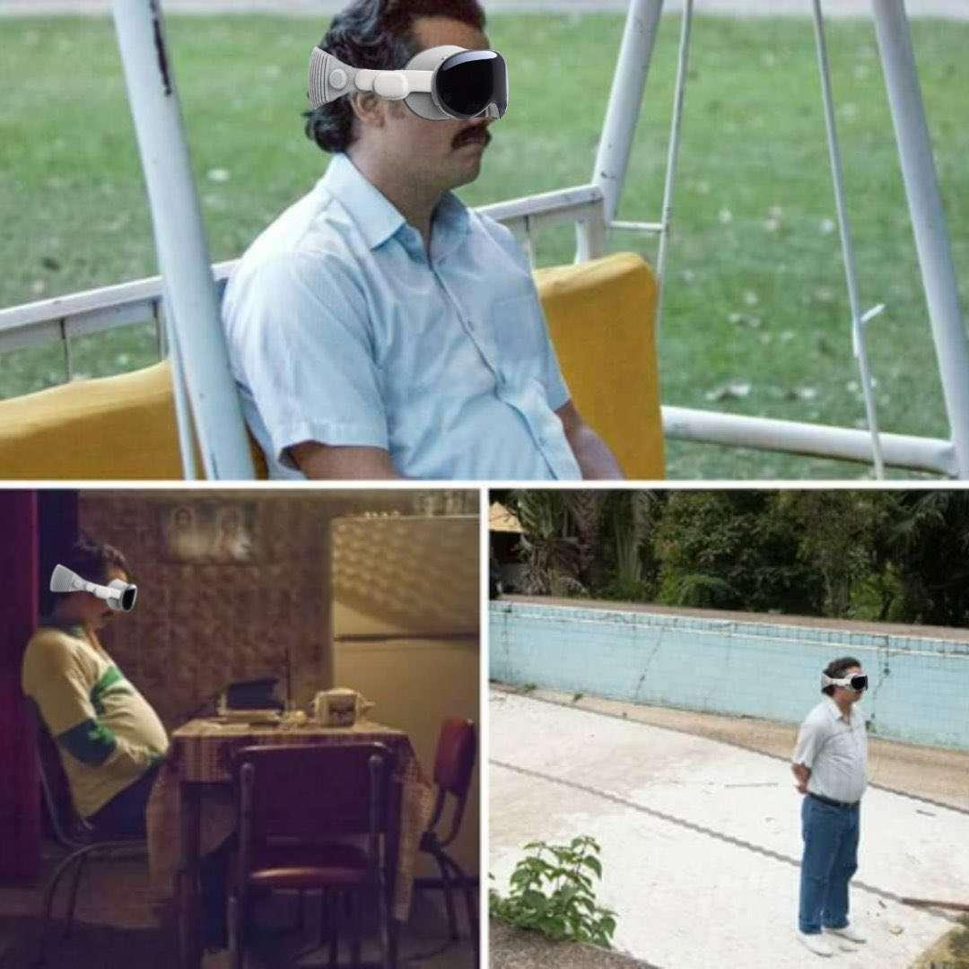
Project IRAS
Working towards improving the quality of life for those with color blindness, hearing issues, and to break language barriers.

